Slide 1


This talk is not about LTE vulnerabilities
Why isn’t it working?

Slide 2
Scared Poopless – LTE and *your* laptop
Disclaimer:
During the slides you will be exposed to hilarious hacker stock photos from the internet.

Slide 3

Thank you!
Goldy
aSmig

Slide 4
DEMO

Slide 5

What did I just see?
Notes:
Explain demo in detail

Slide 6

Who are we?
Notes:
Who are we?
Jesse is awesome
Mickey is annoying

Slide 7
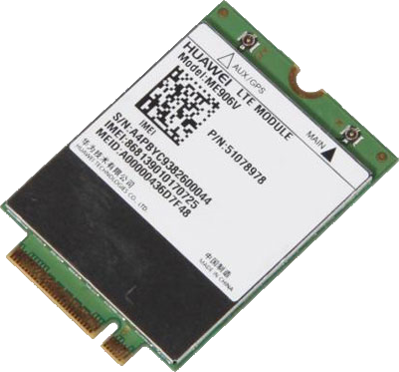

Background
Internal LTE/3G modems and who uses them?
I like to use my own keyboard

Slide 8

Internal LTE/3G modems and who uses them?
Business class devices
I think I have an idea!

Slide 9

Internal LTE/3G modems and who uses them?
Business class devices
How is it plugged in anyway?
Card against humanity 2015 world champion

Slide 10
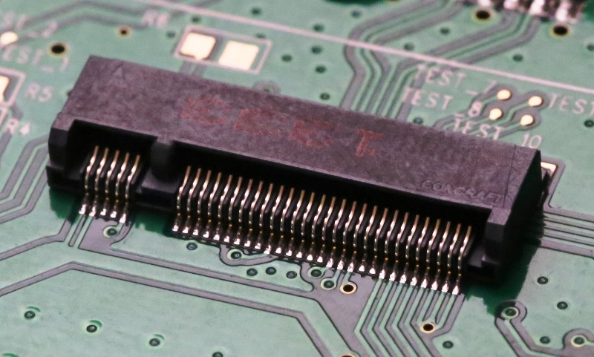


Internal LTE/3G modems and who uses them?
Business class devices
How is it plugged in anyway?

Slide 11

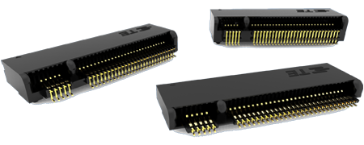
Internal LTE/3G modems and who uses them?
Business class devices
How is it plugged in anyway?
PCIe ×2, SATA, USB 2.0 and 3.0, Audio, PCM, IUM, SSIC and I2C
I forgot mac’s don’t have a CD drive anymore

Slide 12

Internal LTE/3G modems and who uses them?
Business class devices
How is it plugged in anyway?
USB?!
Crap! I just stabbed my usb thumb drive!

Slide 13

Internal LTE/3G modems and who uses them?
Business class devices
How is it plugged in?
USB?!
Why hack this device anyway?
Respect the gas/ski mask

Slide 14
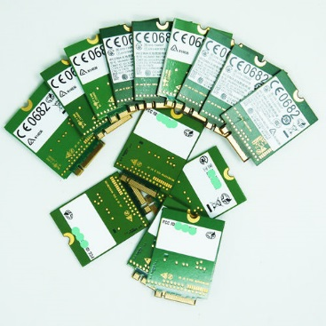
Background
Internal LTE/3G modems and who uses them?
Business class devices
How is it plugged in?
USB?!
Why hack this device anyway?
Module available worldwide
It’s plugged in [INSIDE] your laptop/tablet

Slide 15

Software
Firmware
Hardware
Notes:
High level hack overview

Slide 16

Software
Windows utility for firmware updates
Firmware
Hardware

Slide 17

Software
Windows utility for firmware updates
Firmware
Packed in software utility
Hardware
Low-cost anonymity

Slide 18

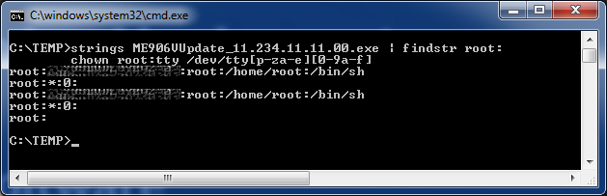
What do you mean you can see my face?
Software
Windows utility for firmware updates
Firmware
Packed in software utility
Hardware

Slide 19
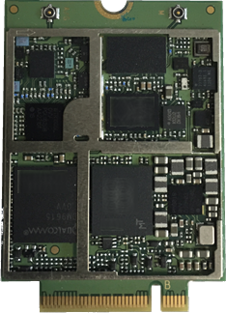
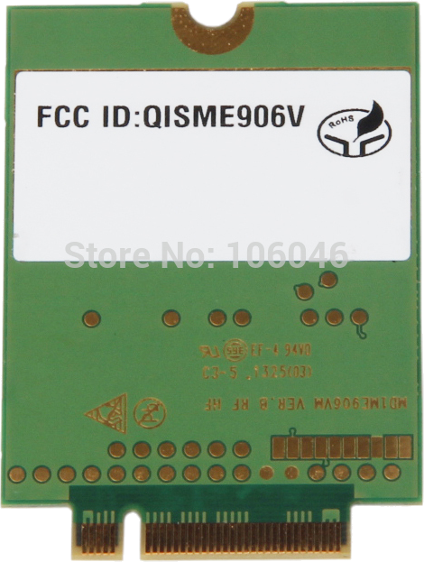
Software
Windows utility for firmware updates
Firmware
Strings is useful
Hardware
Test pads?

Slide 20


Software
Windows utility for firmware updates
Firmware
Strings reveals too much
Hardware
Test pads?

Slide 21
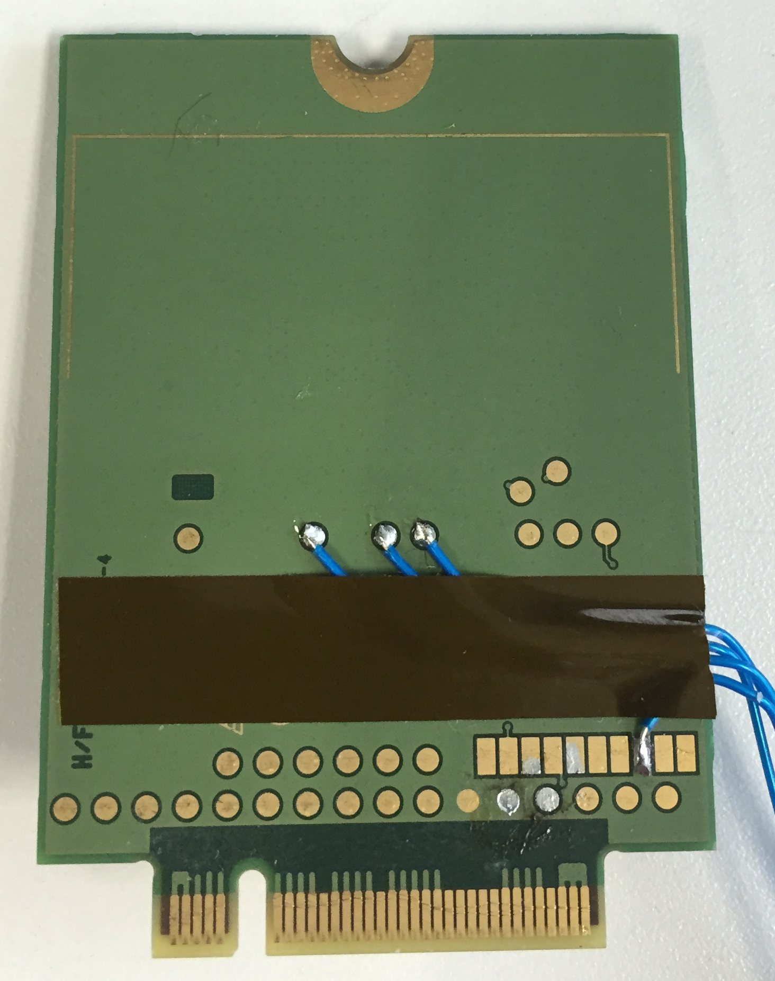

Slide 22
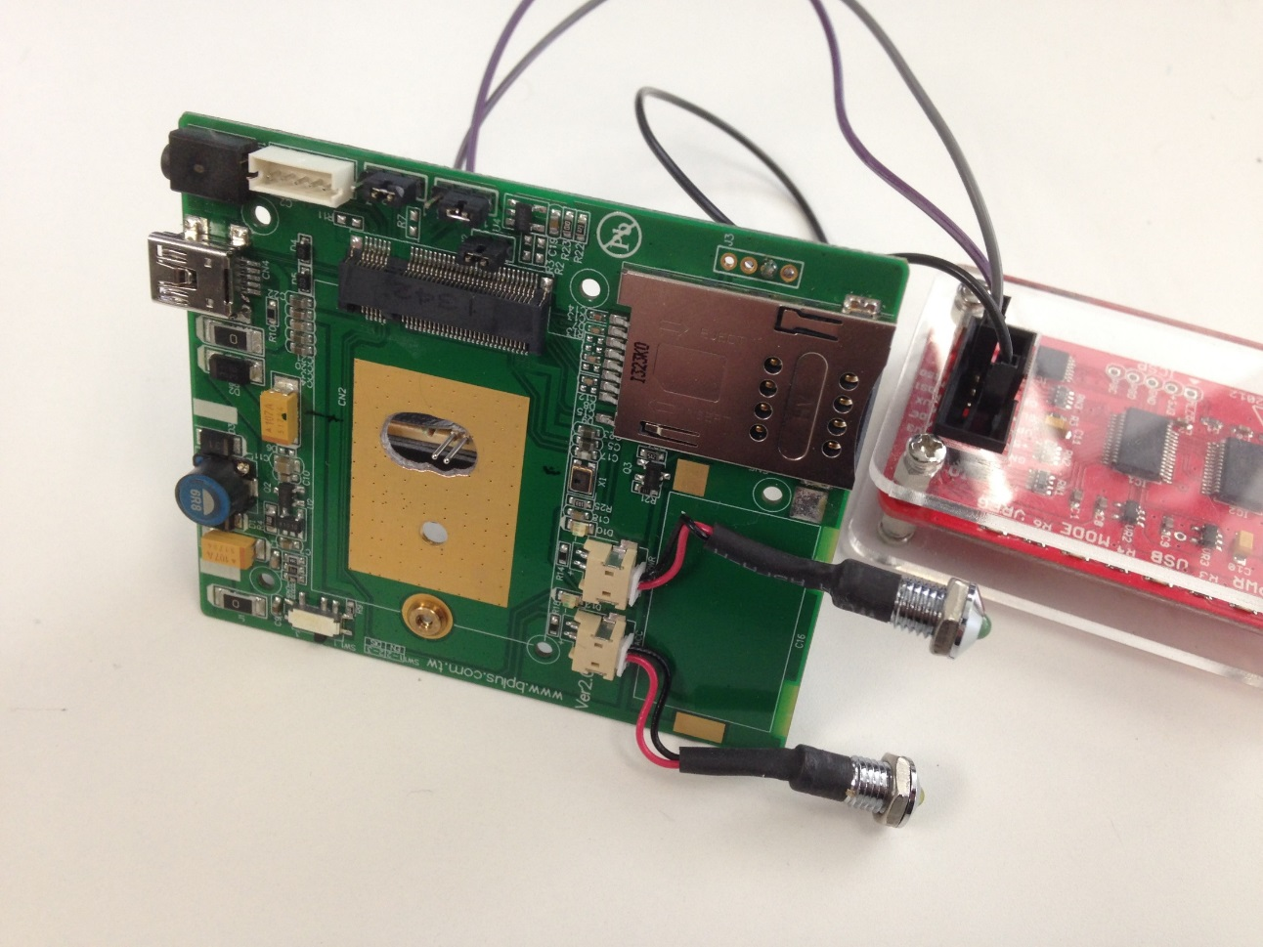
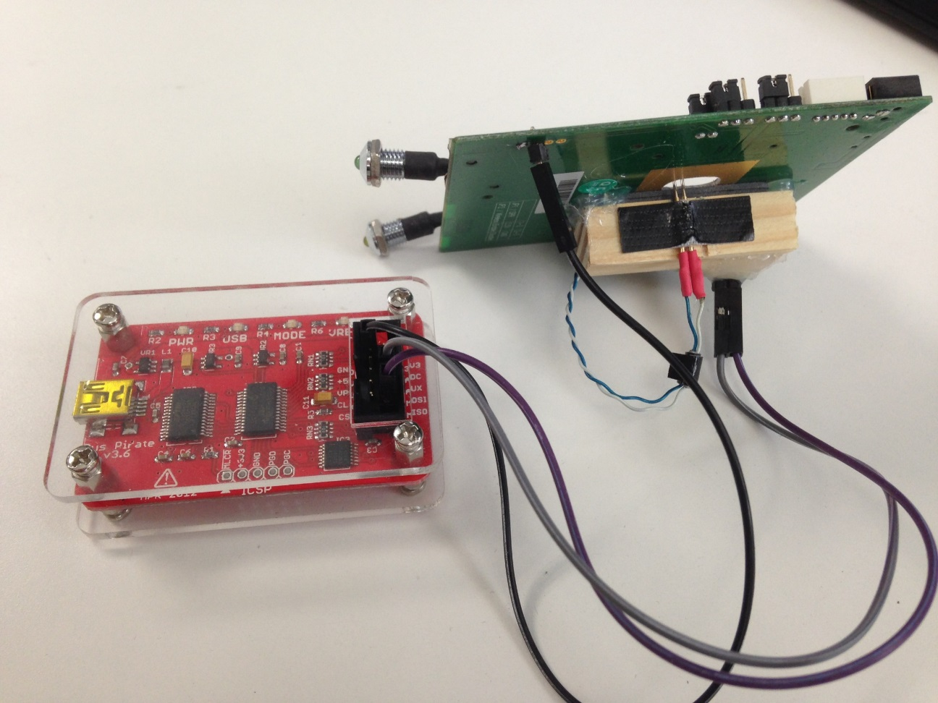

Slide 23
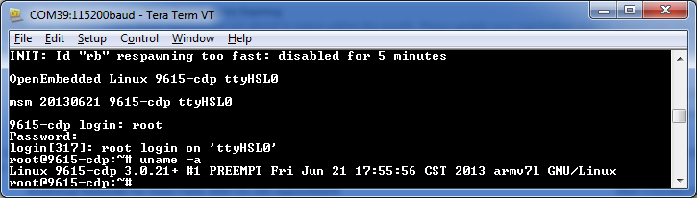
Got root shell!

Slide 24




Happy shell dance

Slide 25

Obligatory success meme

Slide 26

We have root shell on a linux powered independent device inside the physical platform.
There is someone behind me isn’t there?
Notes:
Let’s recap
Real life attack scenario:
Malware staging for persistency
Show CD rom
HID device
Run commands as keyboard
Execute when booting to disable secure boot
USB network adapter sniff communications

Slide 27

CVE-2015-5367: Insecure Linux Image in Firmware
CVE-2015-5368: Insecure Firmware Update Authentication
Notes:
Disclosed vulnerabilities and breakdown

Slide 28
All of the affected products:
Huawei
ME906V/J/E
HP
HP EliteBook 725 G2,HP EliteBook 745 G1,HP EliteBook 755 G2,HP EliteBook 820 G1,HP EliteBook 820 G2,HP EliteBook 840 G1,HP EliteBook 840 G2,HP EliteBook 850 G1,HP EliteBook 850 G2,HP EliteBook 1040 G1,HP EliteBook 1040 G2,HP EliteBook Folio 9470m,HP EliteBook Revolve 810 G2,HP EliteBook Revolve 810 G3,HP ElitePad 1000 G2,HP Elite x2 1011 G2,HP ProBook 430 G1,HP ProBook 430 G2,HP ProBook 440 G0,HP ProBook 440 G1,HP ProBook 440 G2,HP ProBook 450 G0,HP ProBook 450 G1,HP ProBook 450 G2,HP ProBook 640 G1,HP ProBook 645 G1,HP ProBook 650 G1,HP ProBook 655 G1,HP Pro x2 612 G1,HP Spectre x2 13-SMB Pro,HP ZBook 14,HP ZBook 14 G2,HP ZBook 15,HP ZBook 15 G2,HP ZBook 15u HP ZBook 17,HP Zbook 17 G2,mt41 Thin Client
Notes:
Disclosed vulnerabilities and breakdown

Slide 29
Thanks for your research and for giving the DefCon talk. I was there in the
audience.
Huawei is refusing to provide the ME906 firmware update directly to end users.
Instead, they refer to the OEM partner (Sony, etc.), who in turn knows nothing
about this. It's a classic case of finger pointing.
Do you have any insight and/or suggestions on how an end user of one of these
LTE modules can acquire the patch? In my case, it's the Sony variant.
Thanks in advance for your assistance. Please excuse the anonymous disposable
email, but I'm sure you know it's the only way to remain secure.
Regards,
A (Disgruntled) Huawei Modem Owner
Notes:
Disclosed vulnerabilities and breakdown

Slide 30

Firmware structure
Creeper hacker

Slide 31

Updater patch
Updater checks CRC
Updater calculates the correct CRC and compares to the one in the firmware image
Modify updater code to save correct CRC in image instead of comparing it
Modified 6 op codes total.
How do I laptop?

Slide 32
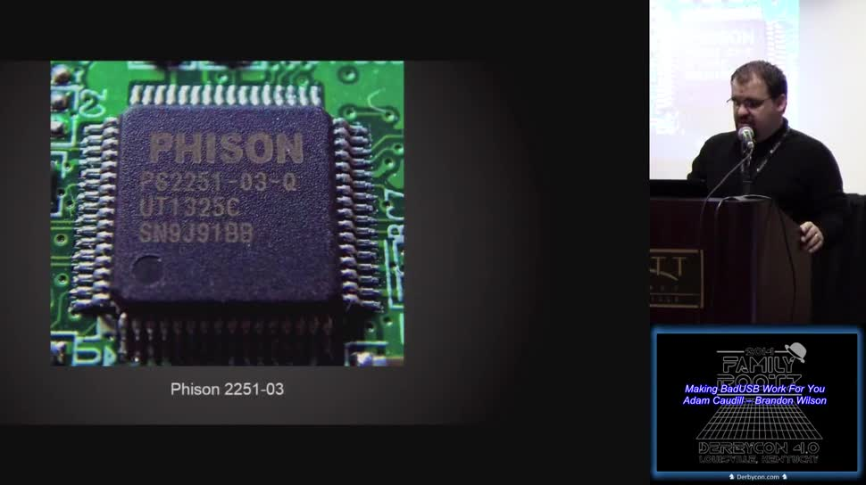
This is why you should do secure firmware updates
NEVER FORGET

Slide 33
What next?

Slide 34

Questions?

